Slide 1
Introduction
Overview of Operating System Tasks
2.1 Frequent-interaction Tasks (Latency-Critical)
2.2 Throughput-oriented Tasks (Latency-Tolerant)
2.3 Security-Related Tasks
3. Latency-Critical / 4. Latency-Tolerant
3.1 Models (from data structure)
3.2 Training (online/offline)
3.3 Inference (user-space/kernel-space)
3.4 Learning Methodologies
3.5 Discussion
5. General Framework
6. Open Problems (Challenges) and Future Works
7. Conclusion
Notes:
Original Version

Slide 2
Introduction
Overview of Operating System Tasks (Background)
2.1 Task1: I/O Scheduling
2.2 Task2: Scheduling
2.3 Task3: Space Allocation
2.4 Task4: Storage Management
2.5 Task5: Network
In section 2, also introduce common heuristics for every tasks; Draw a table about the relationship between tasks and heuristics, and also mark the property as Latency-Critical or Latency-Tolerant Task. Make common examples for each task.
In section 3, for each method in each task, state the ML model, training method, inference location and improvement compared to traditional method (a line in the table).
3. Machine Learning in These Tasks
3.1 Task1: I/O Scheduling
3.2 Task2: Process Scheduling
3.3 Task3: Space Allocation
3.4 Task4: Storage Management
3.5 Task5: Network
4. General Framework
5. Open Problems (Challenges) and Future Works
6. Conclusion
Notes:
Revision 1

Slide 3
I/O Scheduler (Manage a block device’s request queue)
Basic Scheduling: (Queueing Algorithm)
Noop
Completely Fair Queuing
Deadline
Anticipatory
Heuristics:
New queueing techniques (introduce new considerations)
Model-based
Traveling salesman problem
K-coloring problem
Statistic-base
Device-specific Information
History
Notes:
Noop: Random
Deadline: sort based on deadline
Anticipatory: predict the location for next request
CFQ: one queue for one process; round-robin way

Slide 4
Scheduler (Schedule the process on multi-processors)
Basic Scheduling: (Queueing Algorithm)
Earliest Deadline First
First Come First Serve (FCFS)
Least Estimated Work First (LEWF)
Least Estimated Remaining Work First (LERWF)
Heuristics:
Optimization Problem View (Model-based)
Genetic Algorithm
Greedy Algorithm
Dynamic Programming
Distributed Computation
Statistics-based
Historical
Device specific Information
User provided information

Slide 5
Network (Congestion Control & Modify Transmission Rate & Flow)
Heuristics:
Iterative Algorithm (Model-based)
Gradient Projection
Distributed Computation
New Policies (TCP)
Based on RTT
Based on packet loss rate
Combination of both
Queueing
Fair Queueing Algorithm
Start-Time Fair Queueing
Notes:
Each source will have a flow, it will have the transmission rate and order for sending.

Slide 6
Introduction
Overview of Operating System Tasks (Background)
2.1 Task1: I/O Scheduling
2.2 Task2: Process Scheduling
2.3 Task3: Memory Management
2.4 Task4: Network
2.5 Task5: Cloud Computing
3. Machine Learning in These Tasks
4. General Framework
5. Open Problems (Challenges) and Future Works
6. Conclusion
Notes:
Revision 3

Slide 7
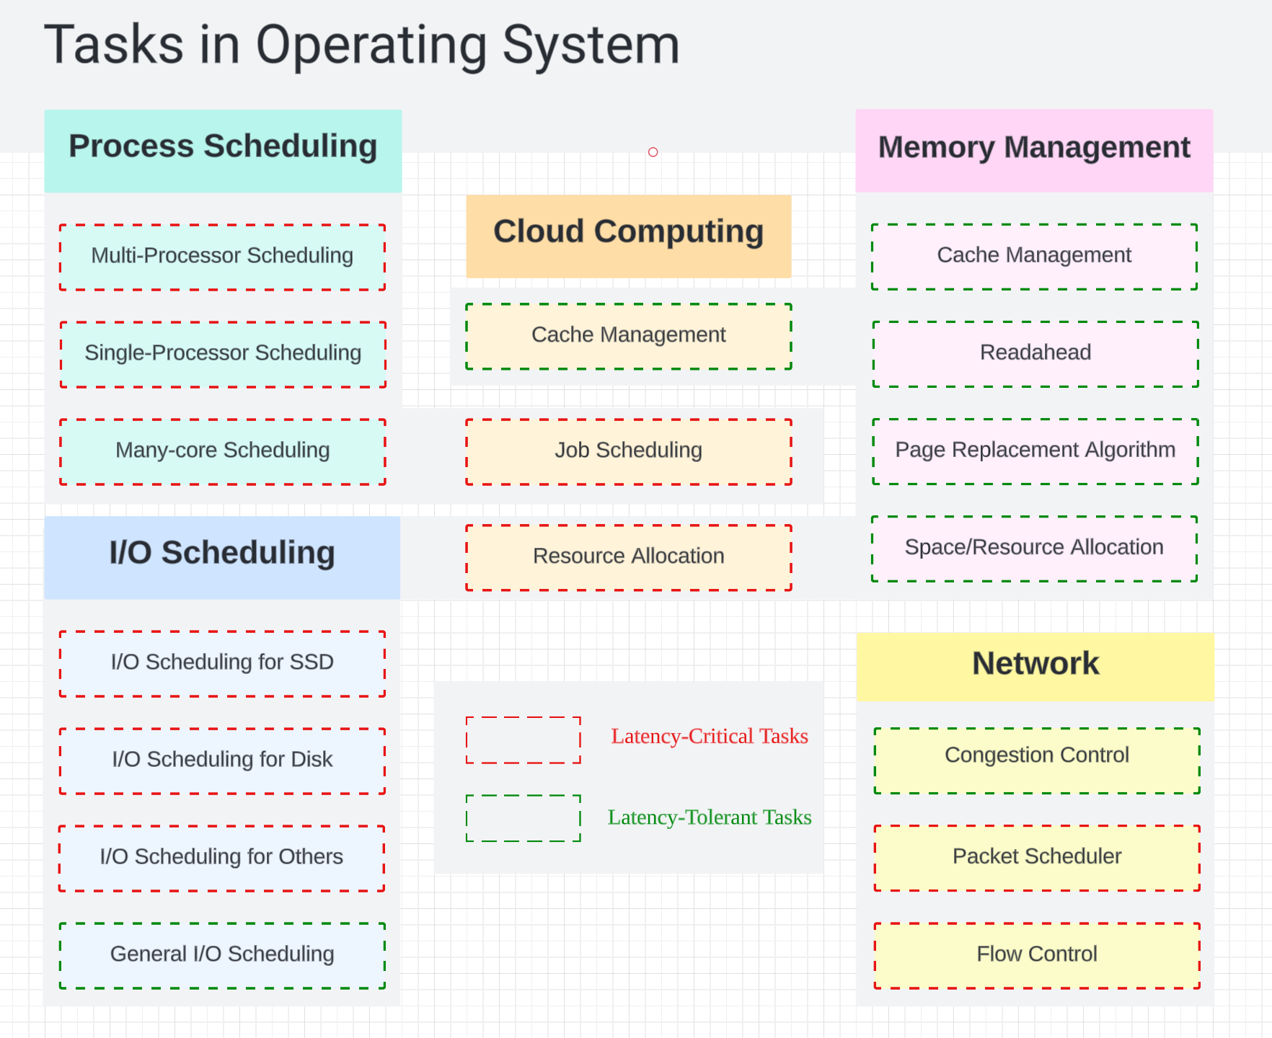
Notes:
Cache Management (Replacement/Size)
Readahead (Prefetch Mechanism)

Slide 8
Basic Algorithms for Page Replacement Algorithm
FIFO
Second Chance Algorithm (have a reference bit)
Clock / Dueling CLOCK
NRU (Not Recently Used)
LRU (Least Recently Used) / LRU-K
Aging
Low Inter-reference Recency Set
WSClock
Dynamic Sort
LR+5LF
Notes:
LRU: first sets all the bits of row k to 1, then sets all the bits of column k to 0
IRR: the number of other pages accessed between two consecutive references to that page
Dynamic sort: sort based on reference count every time quantum

Slide 9
Sample for space allocation
Linux Buddy System（伙伴系统）是Linux操作系统中用于管理内核页框分配和释放的一种内存管理算法。 伙伴系统通过将物理内存划分为一系列大小相等的内存块（或称为页框），并使用二叉树的数据结构来管理这些内存块。每个内存块的大小是2的幂次方，从而方便对内存块进行分割和合并。 当系统需要分配一块指定大小的内存时，伙伴系统会根据请求的大小，在内存块树中寻找最小的合适大小的内存块。如果找到了一个完全匹配的内存块，则将其分配给请求的进程。如果找到的内存块比请求的大小大，那么伙伴系统会将该内存块一分为二，分割成两个大小相等的伙伴块，并继续在树中寻找合适的内存块。 当系统需要释放一块已分配的内存时，伙伴系统会检查该内存块的伙伴块是否也是空闲的。如果是，则将两个伙伴块合并为一个更大的内存块，并继续检查合并后的块是否可以与其他空闲块合并。这样，伙伴系统可以尽量保持内存块的大小相等，以提高内存利用率。 伙伴系统的优点是能够高效地管理不同大小的内存块，并减少内存碎片的产生。它被广泛应用于Linux内核中，用于管理物理内存的分配和释放。

